Slide 1
Schedule and topics
Day 1 |  |  | Day 2 |  |  | Day 3 |  |  | Day 4 |  |  | Day 5
Agile Manifesto Why Agile? What about Waterfall? The "Sprint": What does it mean to iterate? Agile outside the software industry |  |  | Scrum: Pillars and values Events: Daily, Planning, Demo, Retro Roles overview: Scrum Master, Product Owner, The Team |  |  | Role: Scrum Master |  |  | Role: Product Owner |  |  | Role: The Team What is a self-managed team?
Day 6 |  |  | Day 7 |  |  | Day 8 |  |  | Day 9 |  |  | Day 10
What is a backlog? User Stories: Format Definition of Ready Definition of Done differences vs "Product Backlog Item" differences vs traditional documentation |  |  | Event: Refinement Estimation techniques: Story points, Analogy, Poker planning Live poker planning exercise Event: Sprint Planning (Again) Progress metrics: Velocity, Burndown |  |  | Azure devops: Work items Relationships / link Delivery plan Area paths & iteration paths How carry on a Planning Guest accesses (clients, vendors) |  |  | The CTI twist: What is an Internal Product Owner? (aka: PO proxy) What does the Project Manager do? Big teams, Scrum Nexus |  |  | Open Q&A
Calls will be recorded and uploaded every day at:
Shared folder

Slide 2
Agile Fundamentals – Day 2
What is Scrum?
Federico Arazi

Slide 3
Agile is a philosophy Scrum is a framework
Notes:
The analogy: Scrum is to Agile the same as an implementation is to a specification

Slide 4
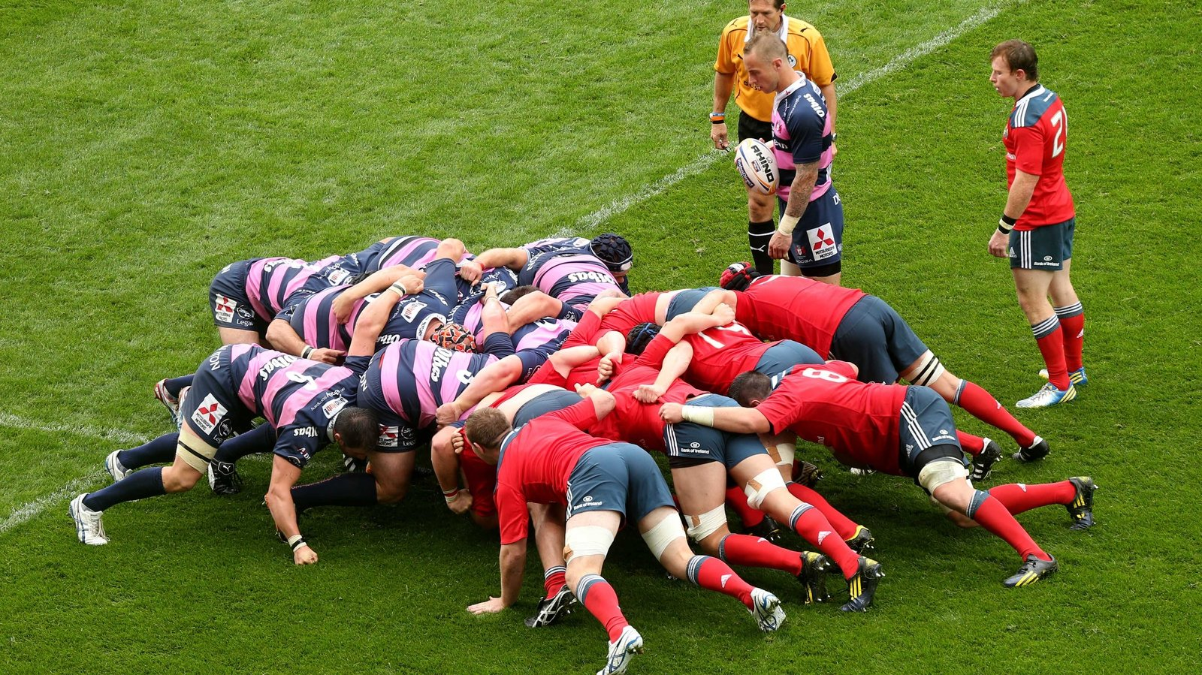
Notes:
@Forms Have you ever played rugby? Yes, No, Technically I had to back at school but I was afraid to get hurt so I just hid during PE … I liked volleyball

Slide 5

The Pillars
Scrum
Transparency
Inspection
Adaptation
Everyone must have visibility
of the project and the product
The process, product and progress
Is inspected regularly, to prevent
undesirable variance
The process or product is
changed quickly when faced to change
Sprint review
&
Azure Devops
Sprint review
&
Retrospective
Sprint
Notes:
Transparency: “Everyone” are primarily the Product Owner, Scrum Master and Team. Stakeholders are a layer removed (see Sprint Review). Meaning, we keep them informed but stakeholders don’t necessarily have access to the devops Project.

Slide 6
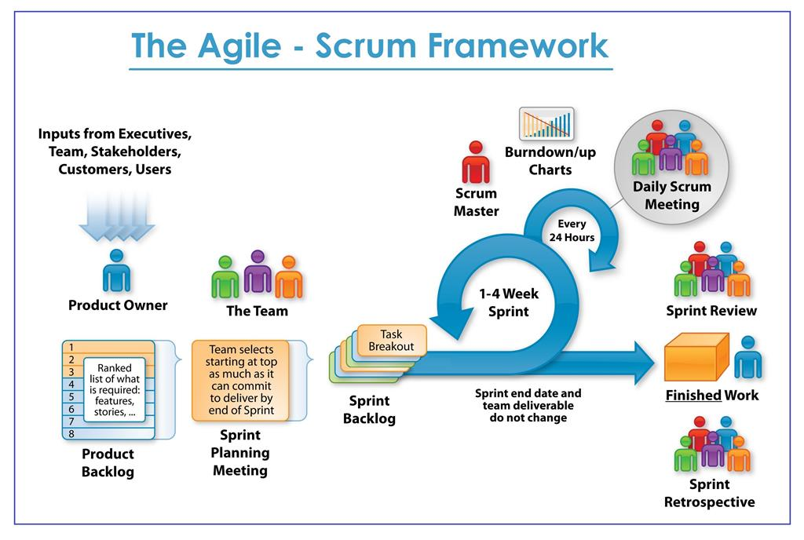
The rules of the game
11
8
10
7
9
5
2
4
3
6
2
1
https://www.neonrain.com/agile-scrum-web-development/
Notes:
Explain that a sprint lasts 2 weeks (by default, and recommended by CTI). It starts with a Planning, ends with a Demo+Retro
Explain backlog briefly: just a list of work to be accomplished

Slide 7
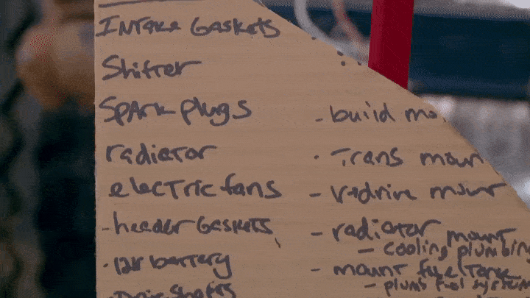
Product Backlog: Might be cardboard
Wheelstanding Dump Truck! Stubby Bob’s Comeback - Roadkill Ep. 52 – YouTube : @12:27
Notes:
Explain backlog briefly: just a list of work to be accomplished
@Forms If a backlog can be a list on cardboard, is tracking work in an Excel spreadsheet valid? Yes it’s optimal, Yes but collaborating in Excel is hard, No because PMO will yell at me

Slide 8

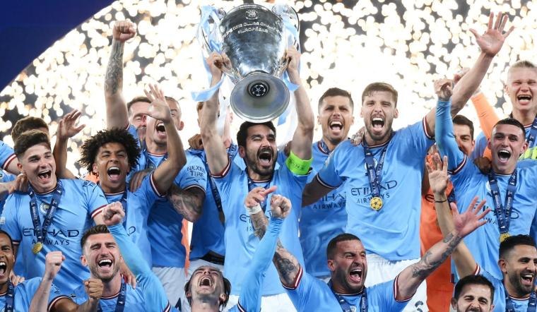
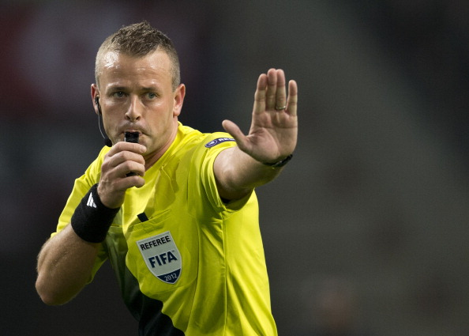
Introduction to the Roles
Product Owner: Prioritizes the backlog by funneling the requirements of the stakeholders. Through this, the product vision is materialized. Must be work for our Client.
Team: Comprised of several roles (BA, Devs, QA), to maximize the ability to deliver functional software independently. Must be allocated 100% to a single project.
Scrum Master: Implements the Scrum methodology, coaches the team, facilitates information exchange and removes project impediments.
Notes:
@forms What role is the most important One? Product Owner, Team, Scrum Master
All answers are wrong, the football analogy holds strong (unintentional rhyme I swear). Success requires everyone. Picture a good team with a bad manager (…Maradona…) , a bad ref, or a nonperforming team (Portugal+Cristiano Ronaldo.)

Slide 9
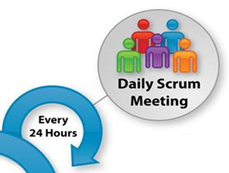
Event: Daily meeting
Happens at the start of the day
The goal is to detect issues and collaboration opportunities
How?
Each team member answers: What did I do yesterday? What am I doing today? Am I facing any issues?
Issues or opportunities aren’t solved at that moment, but in a follow up meeting involving only whoever is necessary (i.e., NOT the whole team!)
Only the Team and Scrum Master participate in this event. The Product Owner and other stakeholders do not participate.
Notes:
When working on distributed remote teams, “start of the day” requires a timezone overlap. Might be the afternoon for someone! (e.g. UK + Mex DELA teams)

Slide 10
Event: Sprint Planning
This event marks the beginning of a Sprint. It’s where we define what will be worked on.
The Product Owner, Scrum Master and Team participate. Optionally the Team can add people (experts or specialist of some kind).
Product Owner and Team collaborate to define the Sprint Goal
The Team selects the backlog items that help accomplish the Sprint Goal
The Product Owner answers questions regarding the work to be done (Refinement)
The Team breaks down the work into tasks that last one day or less. This ensures that the work can be accomplished within the Sprint.
Notes:
Mention that this is Sprint N. An actual Project begins with an “Inception” that we won’t cover today.
The scrum guide prescribes 8hrs planning for a month long sprint, or 4hrs for a 2w sprint. In practice the Planning is split in two, the first half with the PO and the second Team-only.
With the Refinement (not covered today) we seek to shorten these times by doing work in advance (definition of ready, again, not covered today)

Slide 11
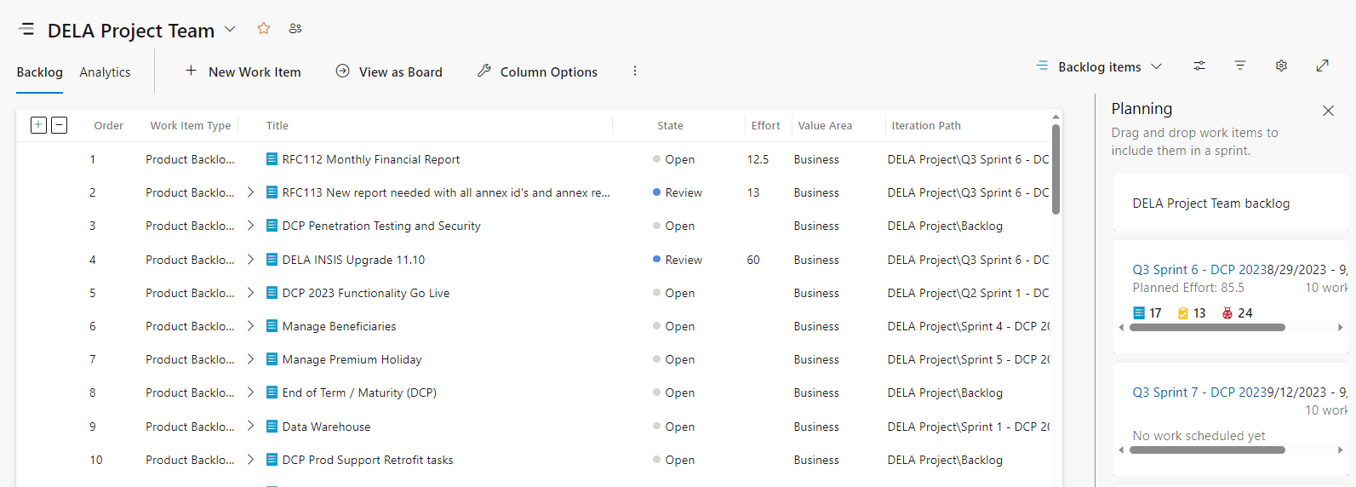
Planning: In devops

Slide 12
Event: Sprint Review (aka Demo)
The goals are to show the results of the Sprint and to obtain feedback
The Team shows what was achieved to the Product Owner and other stakeholders
The Product Owner evaluates what is Done, and what isn’t
Based on the feedback the Product Backlog is adjusted, which is the input for the next Sprint
Notes:
@Forms the Team says that a User Story is finished, but the Product Owner doesn’t like it, who’s right? The Team, the Product Owner
Depends on the acceptance criteria!

Slide 13
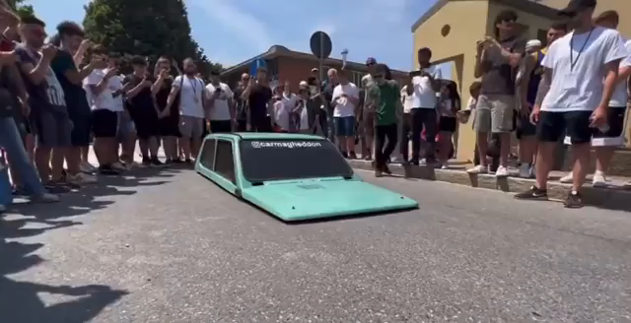
Sprint review: Incremental product, Stakeholders and Feedback

Slide 14
Event: Retrospective
The Goal is to identify ways to improve the quality of the product or process
The Team inspects the last Sprint from all perspectives: people, interactions, process, tools, Definition of Ready / Done, etc.
We also inspect what went well, what problems arose and how they got solved
The output is actionable changes to be done during the next sprint
Notes:
“we need to work more betterer” is not an actionable change!

Slide 15
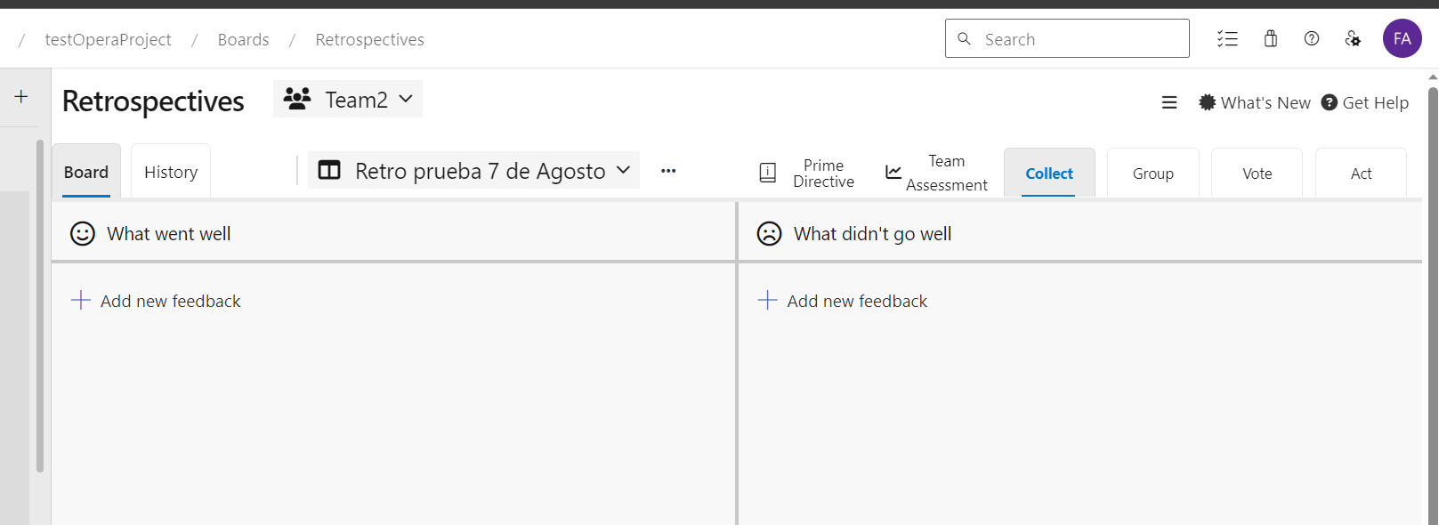
Retro: In devops
Notes:
Mention that we don’t NEED a tool to do a retrospective, but it’s there and it’s fairly useful for remote teams and/or when we want Anonymous feedback.

Slide 16
Scrum Values
Commitment, Focus, Openness, Respect and Courage
The Scrum Team commits to achieving its goals and to supporting each other.
Their primary focus is on the work of the Sprint to make the best possible progress toward these goals.
The Scrum Team and its stakeholders are open about the work and the challenges.
Scrum Team members respect each other to be capable, independent people, and are respected as such by the people with whom they work.
The Scrum Team members have the courage to do the right thing, to work on tough problems.
Notes:
In this slide “Team” is the overarching one, meaning: Team + Scrum Master + Product Owner. In other words, everyone involved in carrying out the Project.

Slide 17
Next up…

Slide 18

Scrum Master: who are they? What do they do? Do they really have 6 arms?

